Slide 1
SSW-810: Software Engineering Tools and Techniques
Python Fundamentals
Prof. Jim Rowland
Software Engineering
School of Systems and Enterprises

Slide 2
Acknowledgements
This lecture includes material from
“How to Think Like a Computer Scientist: Learning with Python 3 (RLE)”, Peter Wentworth, Jeffrey Elkner, Allen B. Downey, and Chris Meyers,
http://openbookproject.net/thinkcs/python/english3e/
And
“Introducing Python”, Bill Lubanovic, ISBN-13: 978-1449359362
http://proquest.safaribooksonline.com/book/programming/python/9781449361167

Slide 3

Today’s topics
Python Overview
Variables, statements, expressions
Operators/Operands
Functions
Booleans, conditionals
If/elif/else
While/for
List, dict containers
Integrated Development Environments (IDE)

Slide 4
Just for fun…

Slide 5
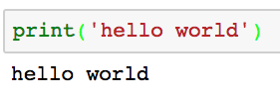
Talking to Python
Say hello!
Python is an interpreted language
Commands are parsed and executed interactively
No need to compile
If you’re unsure of what Python would do, try it!!!
Designing Python experiments is a critical skill
You type the stuff in the pink/grey box
Output from Python

Slide 6
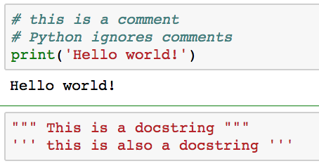
Comments: Note to self!
Comments allow us to leave reminders for us and others who read our code
Comments are critical for readable, maintainable code
Code lives far longer than we expect, and comments help us to understand what we were thinking after the fact

Slide 7
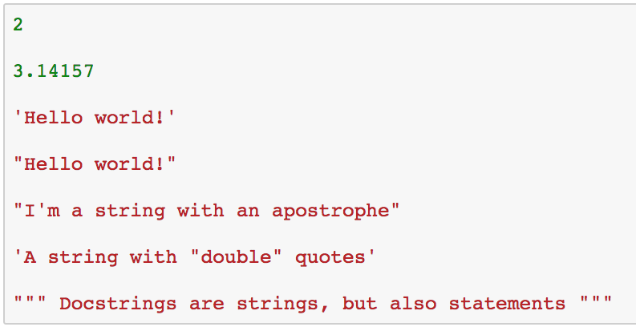
Python primitives (Py ingredients)
An integer number
A floating point number
Two equivalent ways to specify a string
Double quotes make it easy to include apostrophes

Slide 8
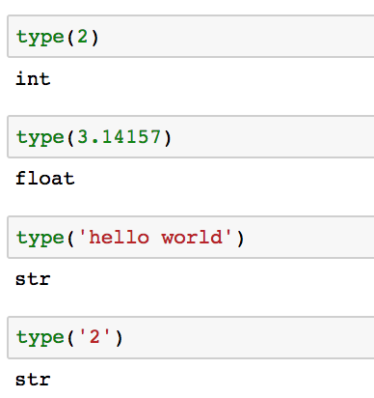
Dynamic typing
Values have types that are determined dynamically
You can ask Python to identify the type of a value
What? Why not an int???

Slide 9
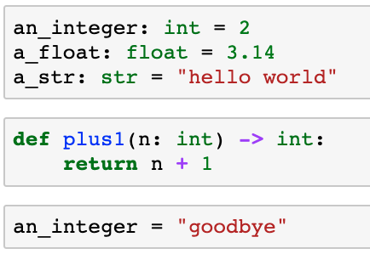
Optional Type Hints
Python 3.6+ allows optional type hints to specify the expected type of variables and functions
Python ignores the type hints at run time
IDEs use the the type hints to warn about potential problems
Plus1 expects to be passed one int and returns an int
What??? We defined ‘an_integer’ to be an int

Slide 10
Optional Type Hints
Type hints specify the data type of variables, parameters and the value returned by functions
If you need … | Example | Use type:
string | “hello world” | str
integer | 42 | int
float | 3.14 | float
integer or float | 42 or 3.14 | float
Boolean | True, False | bool
Function returns None or no value |  | None
We’ll look at many other types, including user defined types

Slide 11
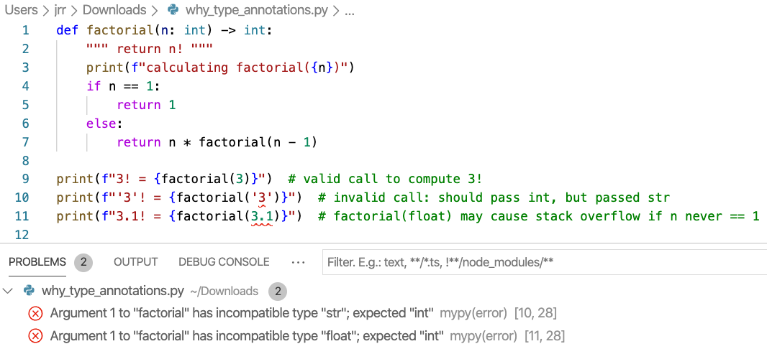
Why specify type hints?
Type hints help to document the code and automatically detect problems
Factorial() expects one int and returns an int
Identified two problems without running the code!

Slide 12
Python keywords (reserved words)
Python reserves some words that can’t be used as names
and | as | assert | break | class
continue | def | del | elif | else
except | exec | finally | for | from
global | if | import | in | is
lamba | nonlocal | not | or | pass
raise | return | try | while | with
yield | True | False | None

Slide 13
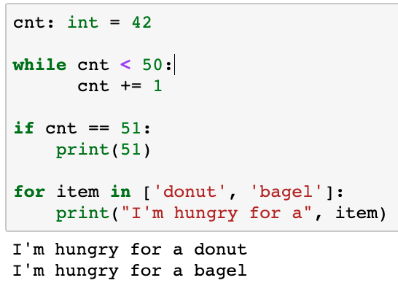
Python statements
Statements allow us to tell Python what we want to do
Examples of statements
The Python interpreter (REPL) evaluates statements
Statements don’t produce results
Python interpreter doesn’t print anything after statements

Slide 14
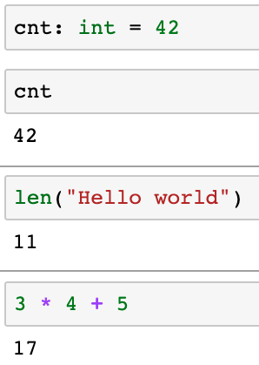
Python expressions
Expressions are combinations of values, variables, and function calls
This is a statement so no output
Evaluate the expression cnt
Call the len function
Evaluate the expression

Slide 15
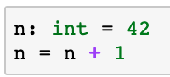
Assignment statements
Python provides syntactic short cuts to improve readability
Python does not support n++, ++n, n--, --n
Statement | Equivalent statement
n = n + 1 | n += 1
n = n - 1 | n -= 1
n = n / 2 | n /= 2
n = n * 2 | n *= 2
n = n % 2 | n %= 2
n = n // 10 | n //= 10
Wait! What’s that?
How can we discover the semantics of ‘%’?

Slide 16
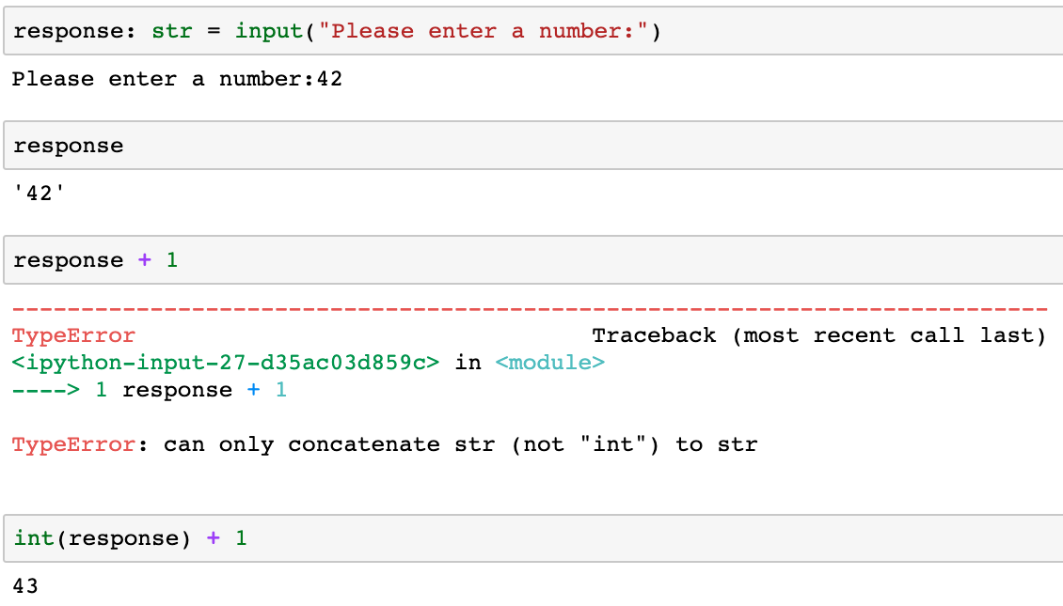
Getting input from the user
Python provides a function to get input from a user
Input always returns a string
Python is unhappy ;-(
Cast strings to integers or floats to do math

Slide 17
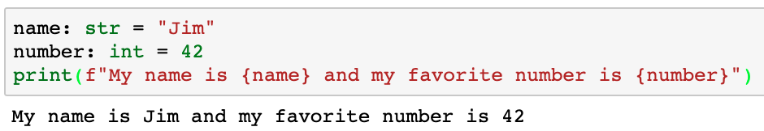
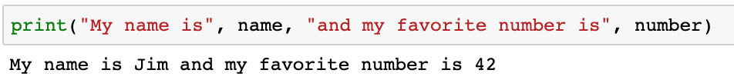
Printing output to the user
Python’s print function writes output to the user
Print accepts any number of arguments of many types
f”… {expr} …” replaces {expr} with the value of {expr} in the formatted string
Don’t forget the ‘f’
f”… {expr} …”

Slide 18
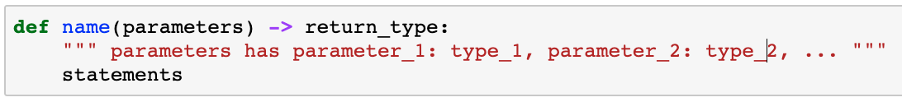
Functions
Functions are a sequence of statements
Where:
name: the function name which must be a legal identifier
parameters: 0 or more identifiers separated by commas. These parameters are available as variables inside the function
return_type: the type returned by the function
statements: one or more statements
Functions may include an optional return statement
Functions always return a value (None by default)

Slide 19
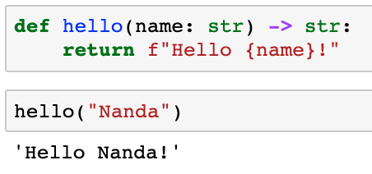
Functions: hello
“Parameters” in the function definition can be used in the function definition
Name has value “Nanda” inside function hello()
Values passed into functions are called “arguments”

Slide 20
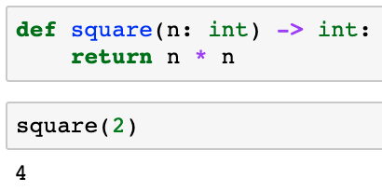
Functions: n²
“Parameters” in the function definition
The parameters are available as variables inside the function
n has value 2

Slide 21
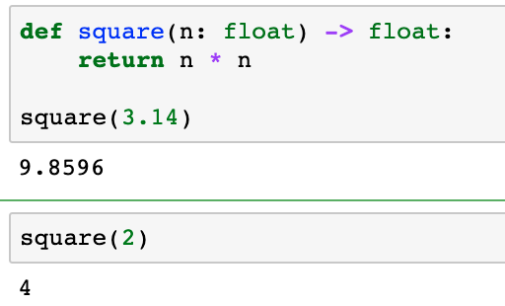
Functions: n²
What if we want calculate square(int) and square(float)?
One function (and type hint) handles both float and int
float type covers both float and int

Slide 22
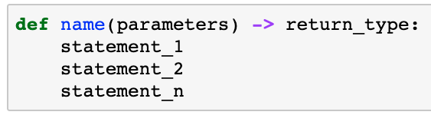
Function definitions
Python uses whitespace to define blocks
Use whitespace consistently
4 spaces is standard to optimize readability
Most IDEs automatically convert tab to 4 spaces
4 spaces

Slide 23
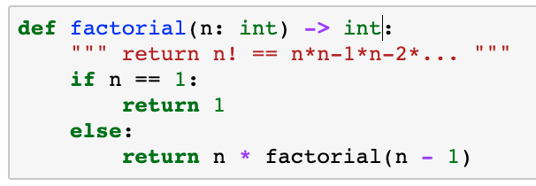
Python whitespace
You must consistently indent or Python won’t understand your function definition
Some languages use { … } e.g. C, C++, Java
Python uses indenting to define related blocks of code
Use 4 spaces to ident
Indent carefully to avoid frustration!
No semi-colons or curly braces in Python

Slide 24
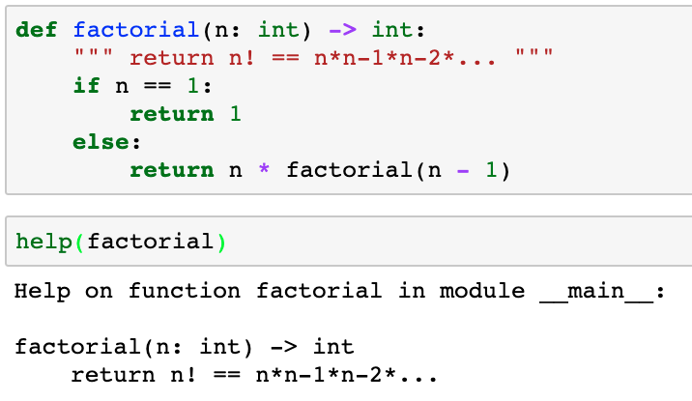
Documenting functions
Every file and function should begin with a docstring
docstring
A function’s docstring is available from the help() function

Slide 25
Fruitful functions
Every function returns a value:
return statement returns an explicit value
Falling out the bottom of the function returns None
Not all functions calculate a value to return to the caller
print(‘Hello world’)
Print returns None but we don’t use the return value or care
Functions that return a useful value are called fruitful functions
Some functions exist for their side effects, e.g. printing

Slide 26
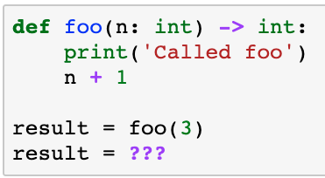
Your turn
What does this function return?
What is result?
3? No
4? No
None? Yes
No explicit return returns None

Slide 27
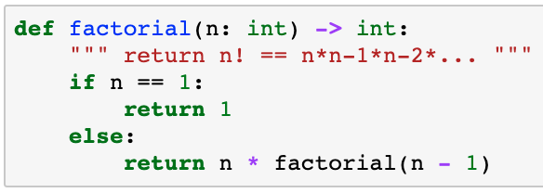
Recursive Functions
A python functions can call other functions
Including itself (recursion)
4! = 4 * 3 * 2 * 1
3! = 3 * 2 * 1
2! = 2 * 1
1! = 1

Slide 28
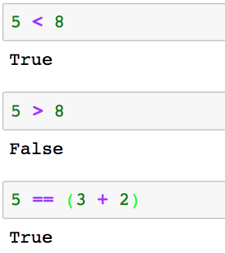
Boolean values
Python includes a Boolean type (bool)
A Boolean value is either True or False

Slide 29
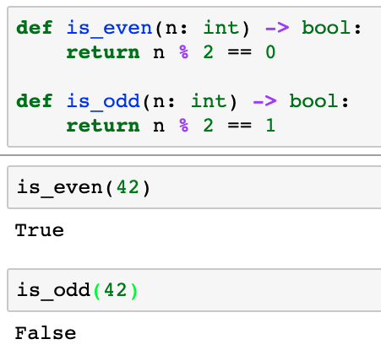
Functions can return True/False
It’s sometimes useful to define functions that return True/False for use as Boolean operands

Slide 30
Comparison operators
Conditionals help to make decisions
Comparison Operator | Semantics | Example
== | Equal | 3 == 4
!= | Not equal | 3 != 4
< | Less than | ‘a’ < ‘b’
> | Greater than | ‘a’ > ‘b’
<= | Less than or equal to | 3 <= 4
>= | Greater than or equal to | 3 >= 4

Slide 31
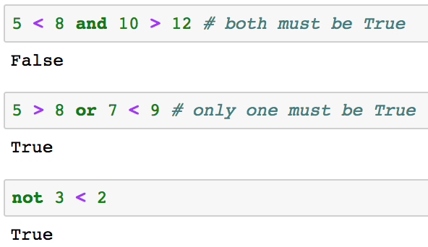
Logical operators
Combine logical expressions with logical operators:
and, or, not

Slide 32
Truth tables for logical operators
x | y | x and y¹ | x or y²
False | False | False | False
False | True | False | True
True | False | False | True
True | True | True | True
¹ Both must be True or x and y is False
² Only one of x, y must be True for x or y to be True

Slide 33
Short circuiting
Python evaluates logical expressions from left to right
If the left operand of an or operator is True then the right operand is not evaluated and the expression is True
If the left operand of an or operator is False then both operands are evaluated and the result depends on the right operand
If the left operand of an and operator is False then the right operand is not evaluated
If the left operand of an and operator is True then both operands are evaluated and the result depends on the right operand

Slide 34
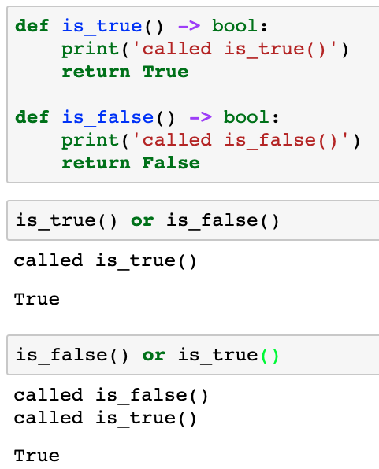
Short circuiting: or(disjunctions)
is_false() is not called
Both is_false() and Is_true() are called

Slide 35
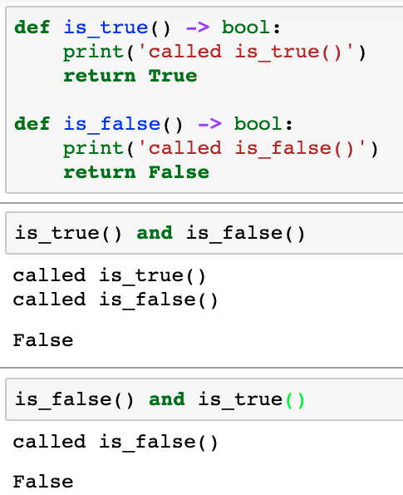
Short circuiting: and(conjunctions)
Must call both functions to determine if the expression is True/False
Only first function must be called to know that the expression is False

Slide 36
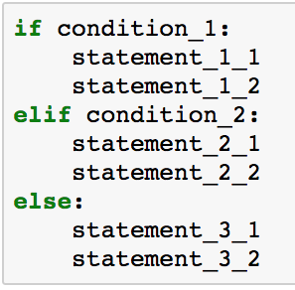
if .. then … elif ... else statement
0 or more elif statements
0 or 1 else statements
If condition_1 is True, then execute the statements in this block
If condition_1 is False and condition_2 is True, then execute the statements in this block
If all previous conditions are false, then execute the statements in this block

Slide 37
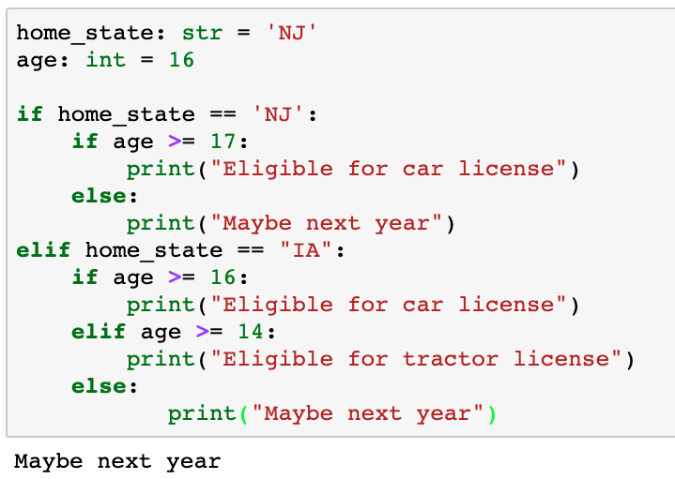
Nested if statements
Which else goes with which if?
Indentation defines the statement blocks
Careful indentation is critical!
Python does not have a case/switch statement

Slide 38
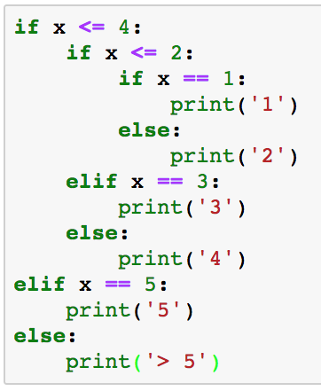
Your turn
What is the output if x == 3?
McCabe’s Cyclomatic complexity measures the number of potential paths through if statements.
Empirical studies show that functions with more than about 10 different paths are too hard to maintain.
Keep the number of alterative paths small to improve readability and maintainability.

Slide 39
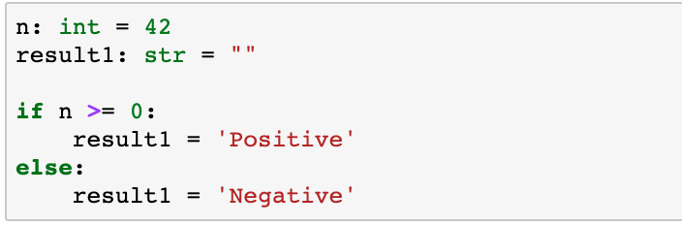
Conditional one liners
We can collapse a conditional into a single line
True_result if Conditional_expr else False_result
This is known as the ternary operator
Code may be more concise, but possibly harder to read

Slide 40
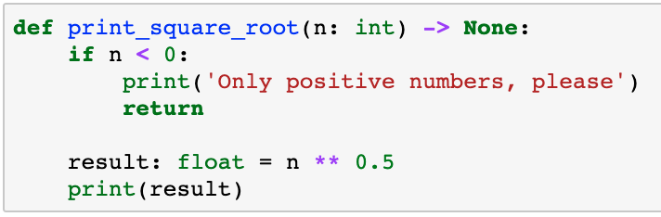
return – Get me out of here
Functions normally return after the last statement, but you may want to return from the middle of the function
Careful with early return from functions
May make functions harder to read and understand
Early return may be best solution in some cases

Slide 41
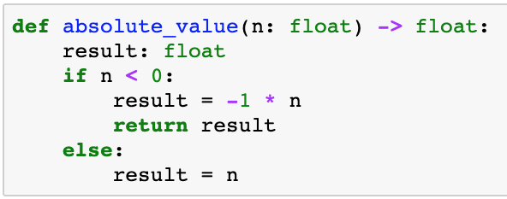
return – Don’t let this happen to you
float handles both int and float
What’s returned if n >= 0?
result?
No! No explicit return statement returns None
Insure that all exit paths have return statements

Slide 42
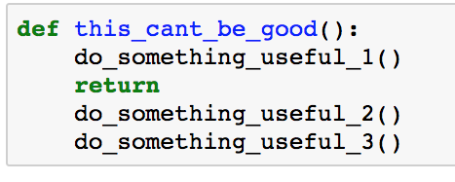
return – Don’t forget me!!!
What’s wrong with this code?
Be alert for unreachable statements
Static analysis tools can help to find these problems
These statements will never be executed

Slide 43
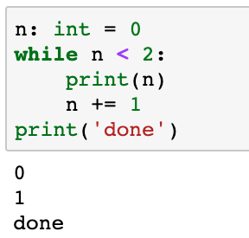
while loops
while conditional:
statement_{1..n}
statement_{n+1}
Execute statement_{1..n} while conditional is True
Verify that the Boolean expression eventually becomes False to avoid infinite loops

Slide 44
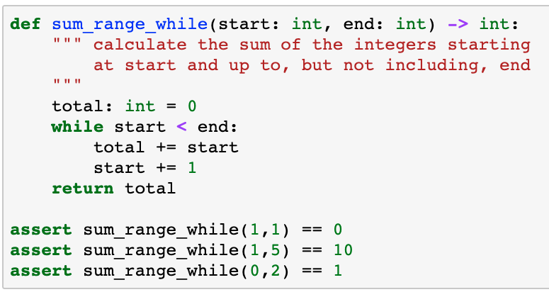
Write a function…
Write a function to calculate the sum of a range of integers
What if start >= end?
assert expr complains if expr is not True

Slide 45
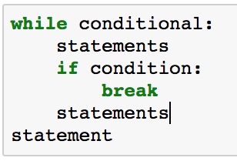
break out
Sometimes you want to break out of the middle or end, rather than the top, of a loop
break leaves the loop and execution moves to the first line following the while block

Slide 46
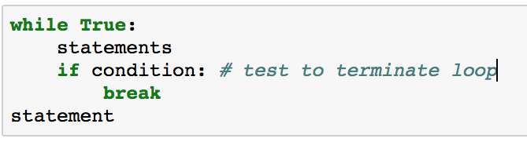
do while?
Python does not include a do while statement…
… but it’s easy to simulate

Slide 47
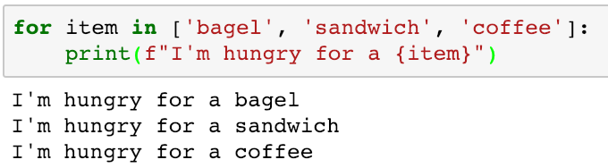
for loops
for loops iterate through sequences
Python has many different sequences, e.g. lists, dicts, tuples, strings, ranges, generators, …

Slide 48
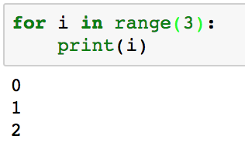
for (i = 0; i < 3; i++){ }
for loops iterate through sequences
What about a range of 0 to n?
range(limit) returns a sequence of integers from 0 up to, but not including, limit

Slide 49
Advanced/Optional
Slides marked
contain topics that we’ll cover in detail later in the course
if comfortable_with_advanced_topics():
use_in_homework_assignments()
elif confused():
don’t_worry_for_now()
use_simpler_approach()
Advanced/Optional

Slide 50
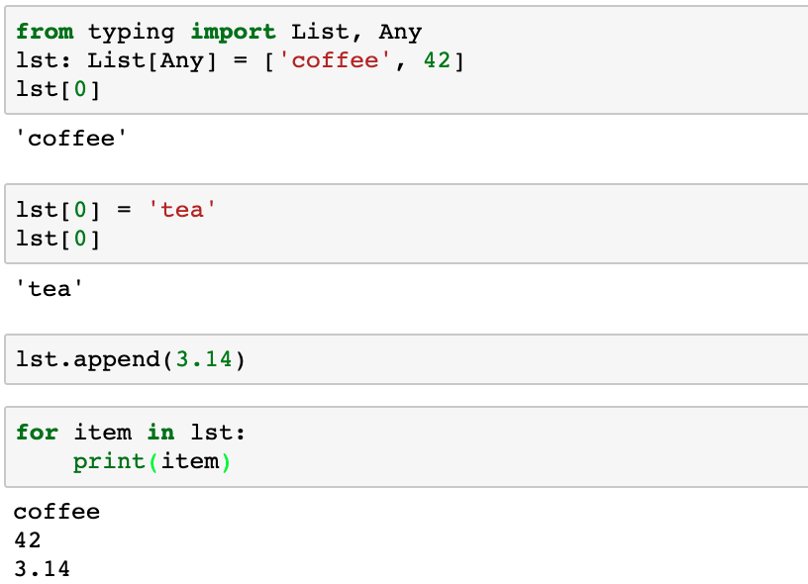
Python lists
Advanced/Optional
Lists hold arbitrary, ordered values of different types
Create a list
Access individual elements with slices offset from 0
Change the list with slices
Append items to the end of the list
Iterate through the elements in the list

Slide 51
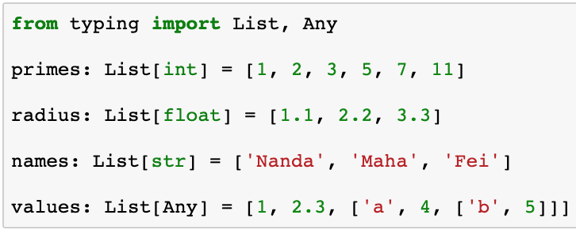
Type hints for lists
Advanced/Optional
Lists hold arbitrary, ordered values of different types
If all elements in the list have the same type, then specify that type in the type hint
Import type hints from typing
Type of values in the list

Slide 52
Finding an item in a collection
Advanced/Optional
I need to find my friend Nanda
I can knock on every door until I find him …
… or I can look up his address and go directly to the right door
Dictionaries map keys to values
Nanda Apt 5B

Slide 53
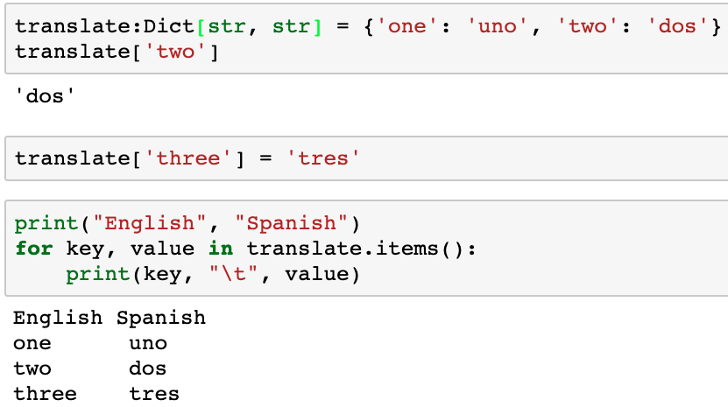
Python dict maps a key to a value
Advanced/Optional
Key
Value
Initialize a dict
Use key to retrieve associated value
Add new key/value pairs
Iterate through key/value pairs
The order is undefined…

Slide 54
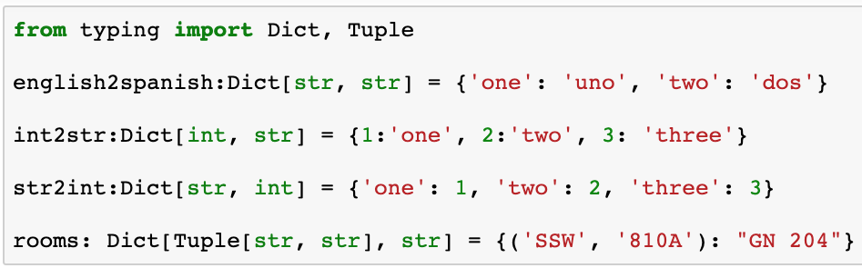
Type hints for dicts
Advanced/Optional
Lists hold arbitrary, ordered values of different types
If all elements in the list have the same type, then specify that type in the type hint
var: Dict[key_type, value_type]
Type of the key
Type of the value

Slide 55
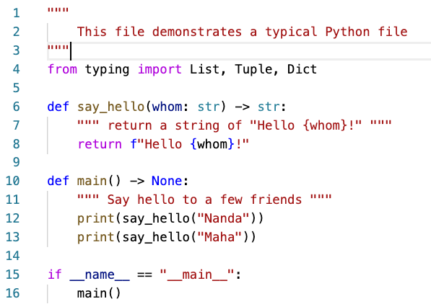
Typical Python Program Files
Docstring to describe the file
Imports go at the top of the file
Functions with docstrings and logic
main() function with test cases and user interaction
Call main()

Slide 56
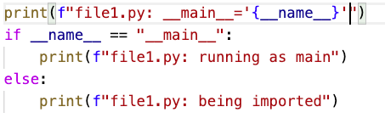
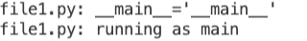
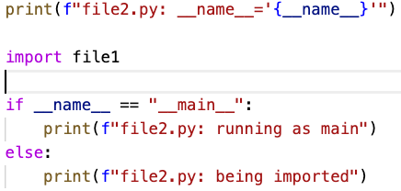
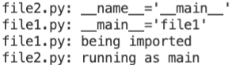
__name__ identifies current module
“__foo__” specifies something magic in Python
Advanced/Optional
file1.py
$ python file1.py
__name__ specifies the name of the current module
file2.py
$ python file2.py

Slide 57
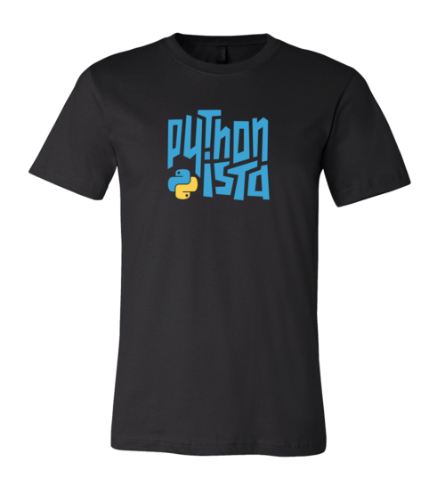
Is that all?
Python has many more features that we’ll explore throughout the semester but this gives you enough to get started on your journey to becoming a Pythonista…

Slide 58
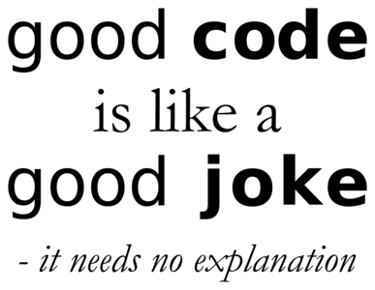
Coding style guidelines
Code lives forever so make it readable and maintainable
Good comments are critical
Don’t explain the obvious but do explain subtleties
Include a comment at the top to explain the problem
Explain major sections
Use meaningful variable names
Use consistent white space/blanks
var: type = value
Blank lines between sections
We’ll explore more formal guidelines later

Slide 59


Slide 60

Integrated Development Environments
You’re ready to write Python code!
Alternatives for interacting with Python
Type into the Python interpreter
Create a .py file in a text editor
Use an Integrated Development Environment (IDE)
Your choice, but an IDE will be easiest and most efficient after a short learning curve
Many IDEs available
VS Code, PyCharm, Jupyter, PyScripter, IDLE, …

Slide 61

Canopy
Free version of Canopy does NOT include debugger
Run your program
Save program file changes
Code Editor
Variable explorer
Python Console
Stack Trace
Program input/outut

Slide 62

Visual Studio Code
Run your program, step through the code, …
Variable explorer
Code Editor
Stack Trace
Program input/outut

Slide 63

PyCharm
Run your program, step through the code, …
Code Editor
PyCharm is VERY powerful and includes many powerful features but may be harder to get started
Stack Trace
Variable explorer
Program input/outut

Slide 64

Jupyter Notebook
Notebooks run in a browser
Markdown Cell
Jupyter is very popular for Data Science because you can combine code, Markup, output, etc.
Describe the logic and results of the analysis in a single, executable notebook
Code Cell
Graphic output from running the code cell

Slide 65

Debugging Jupyter Notebooks
Code Editor
Debugging may be less convenient, with command line ipdb/pdb debugger
Force a breakpoint
Program input/outut

Slide 66
IDE Summary
IDE Product | Advantages | Disadvantages
VS Code | Supports many languages, works well with Python
PyCharm | Very powerful | Steeper learning curve than other IDEs
Jupyter Notebooks | Very popular choice for Data Science, exploration, and sharing results | Debugger is not tightly integrated and requires command line interface
It’s your choice!
Pick one of these, or any other you prefer, but you must use an IDE for this course

Slide 67
Optional review sessions
A little confused about anything in the lecture?
Stuck on the homework assignment?
Optional online review session Tuesday evenings at 6:00 PM
See Canvas for URL
Be ready to ask questions

Slide 68

Questions?

